Slide 1
Spanish Supersites. Directive 2024/2881
TFMM Potsdam, May 5th 2025
GádorIndra Hidalgo gihidalgo@miteco.es

Slide 2

1
SUPERSITE IMPLEMENTATION
NUMBER OF SUPERSITES AND CONSIDERATIONS FOR SUPERSITE SELECTION
2
COORDINATION OF SUPERSITE GRID
3
FUNDING OF SUPERSITES
MINISTRY’S EXCEL CALCULATOR TOOL
4
TENTATIVE SELECTION
URBAN AND RURAL SUPERSITES
5
OPEN QUESTION
EUROPEAN COMMISSION BUDGET FOR SUPERSITES

Slide 3

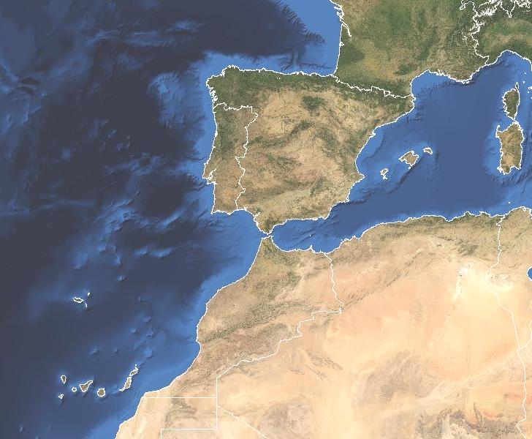

Supersite implementation
Spain’s surface 505.957 km²
49 million people
5 Urban Supersites + 5 Rural Supersites
Considerations for Supersite selection
Location of pre-existing air quality stations
Budget
Representativity
Easy Access for maintenance
Other factors

Slide 4
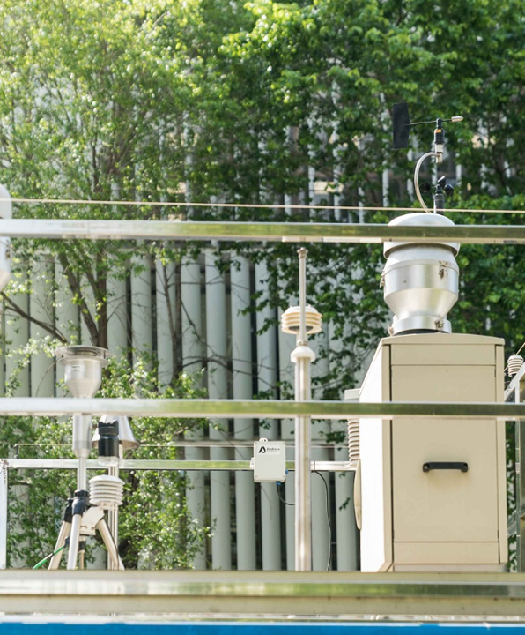
Coordination of the Supersite grid
Under study to find the best coordination method
The Supersites are located in different regions
Competences transferred to the different regions
Complex maintenance
  Very specific equipment
  High operation costs
  Frequent laboratory analysis
  Easy access of technicians to supersites (mountain, etc.)

Slide 5

Funding of Supersites
IMPLEMENTATION → CAPEX
OPERATION & MAINTENANCE → OPEX
MINISTRY FOR ECOLOGICAL TRANSITION AND DEMOGRAPHIC CHALLENGE provided regions with an EXCEL CALCULATOR TOOL
This tool facilitates the estimation of the Supersites costs:
  New equipment
  Supply costs
  Includes laboratory analysis
  Audits
  Electricity, etc.
We can estimate the real cost of implementation
Selection of supersites considering cost & other factors

Slide 6

Tentative locations
Urban supersites:
Madrid (capital)
Barcelona
Bilbao
Valencia
Granada
Urban Supersite
Rural Supersite
Rural supersites:
Madrid region
Barcelona region
Asturias (north)
Castilla la Mancha (Spanish central plateau)
Granada region (south)

Slide 7

Open question
Does the European Commission have a budget line for the implementation of supersites?

